Slide 1
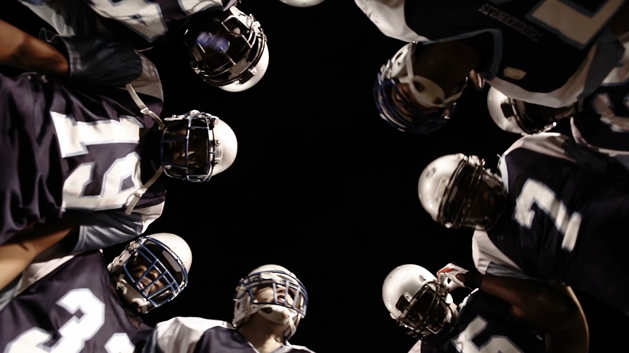
NFL Sports Betting Analysis
Betting for Starters
By: Dario Micucci, Justin Butler,
Rebeca Perez & Brettney Chau-Dang

Slide 2
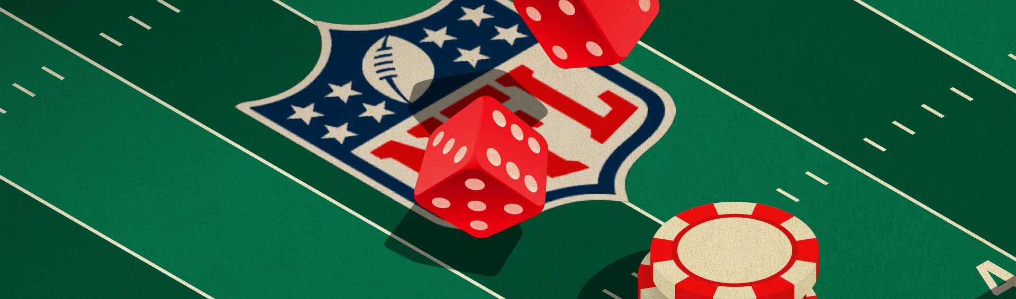
Introduction
Primary choice for online gambling
Market value in 2021 was $75.41 Billion USD
Canadian market value $2.64 Billion in 2021
Who would you place your bet on?

Slide 3
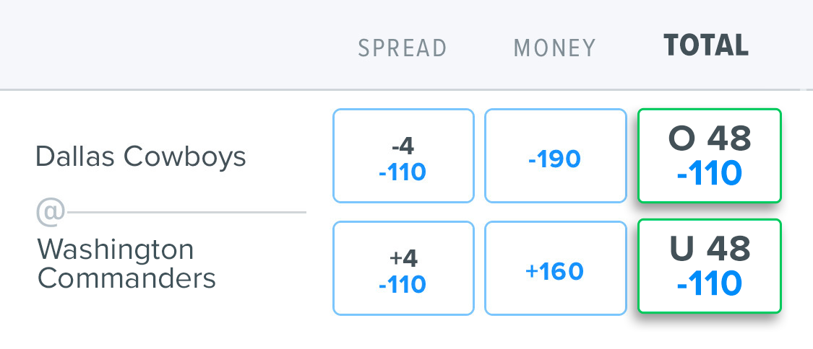
Over
/
Under
AKA “Totals Bet”
A bet on the total combined score of a single game
Higher or lower than a pre-determined value

Slide 4
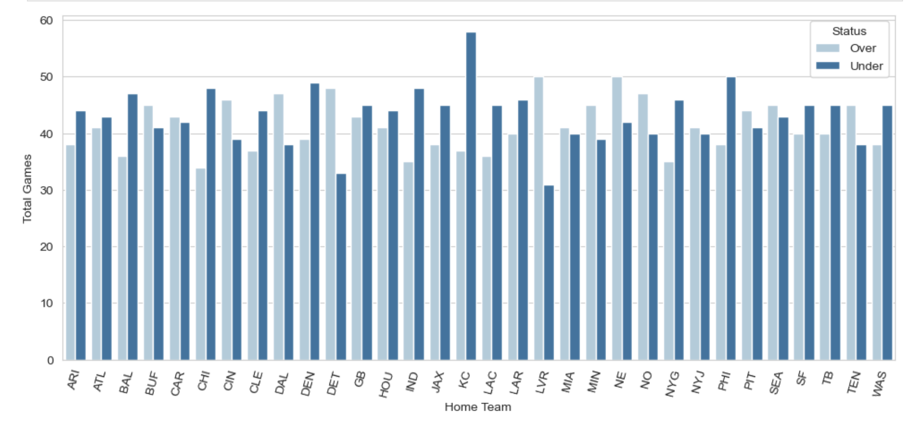
Total Games vs. NFL Team
Top NFL Team that was Over
Top NFL Team that was Under

Slide 5
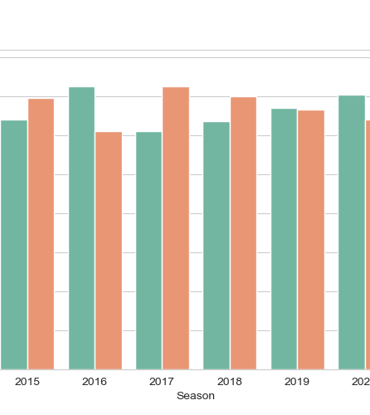
Total Games vs. Season
Regular season games from 2013 to 2022
Total amount of games that were higher or lower
60% of games were Under over the last 10 Seasons

Slide 6
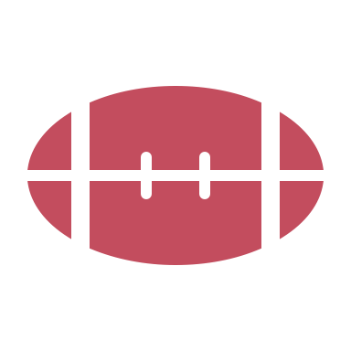
Analysis:
How is NFL betting affected by the type of stadium the games are played in?

Slide 7
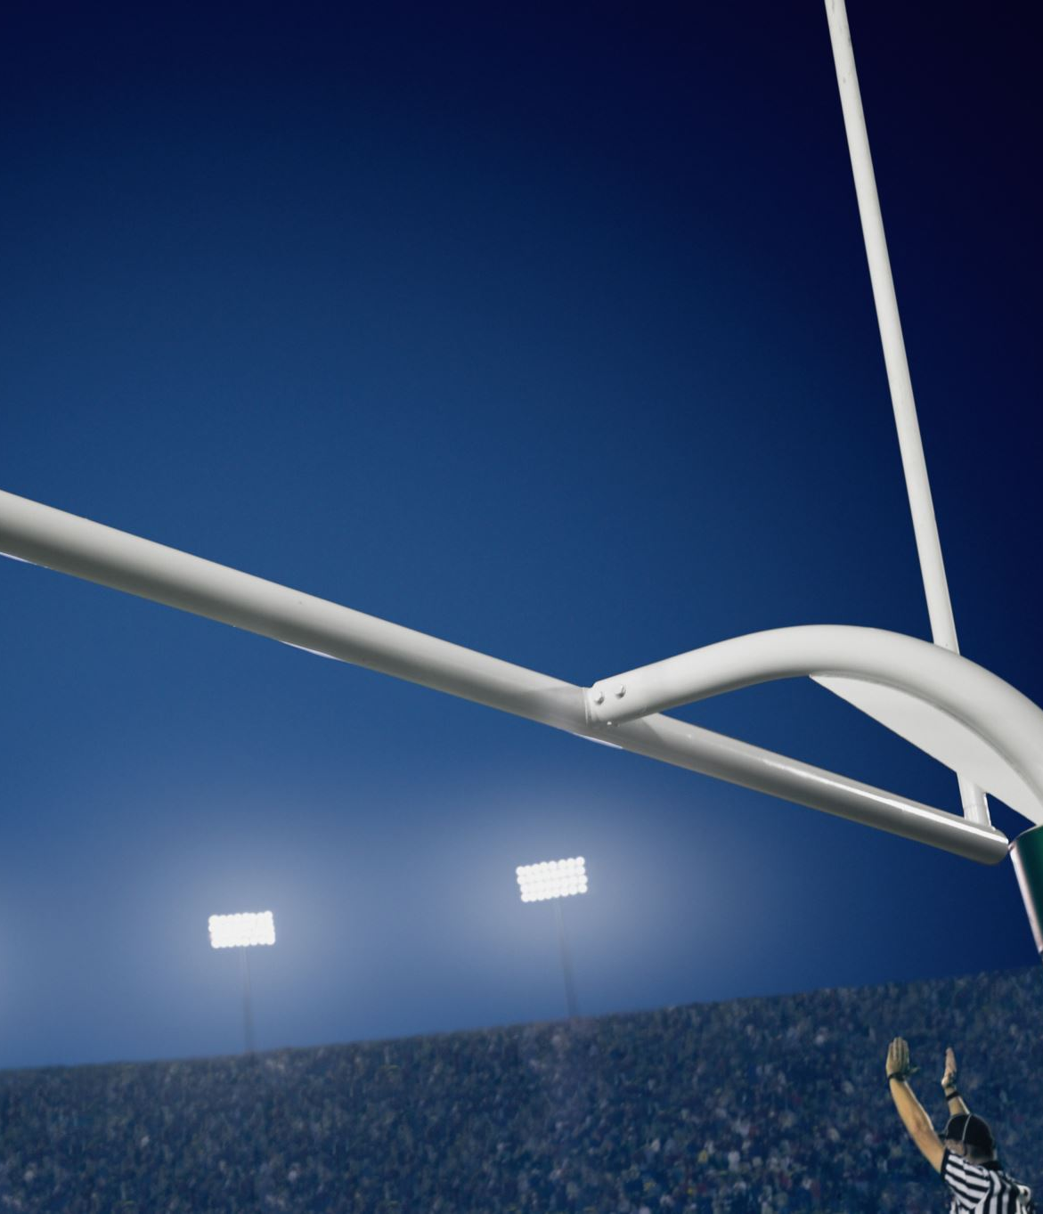
Stadium Types are 1) Indoors: Dome Stadium 2) Outdoors: Open Air Stadium
Is stadium type, being either indoor or outdoor factored in when the over/under line is set for games?
Is there a homefield advantage to teams playing their home games indoors versus outdoors?

Slide 8
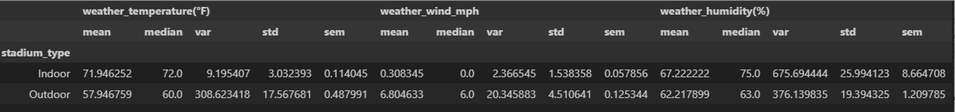
Weather Analysis by Stadium Type
Outdoor Temperature Variance 30 times larger than Indoor
Outdoor Wind Speed Variance almost 10 times larger than Indoor
Higher Humidity Statistics for Indoor Stadiums are misleading as tens of thousands of people breathing in an enclosed space increases Humidity

Slide 9
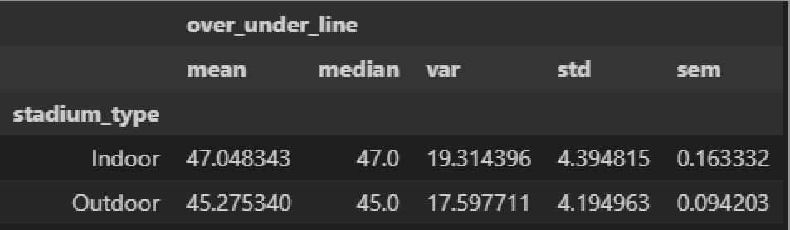
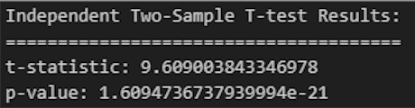
Over/Under Line by Stadium Type
Alternate Hypothesis: If stadium type is factored into how the over/under lines are set, then the average over/under line for games played indoors should be higher than the games played outdoors.
Null Hypothesis: If stadium is NOT factored into how the over/under lines are set, then the average over/under line for games played indoor will NOT be higher than the games played outdoors.

Slide 10
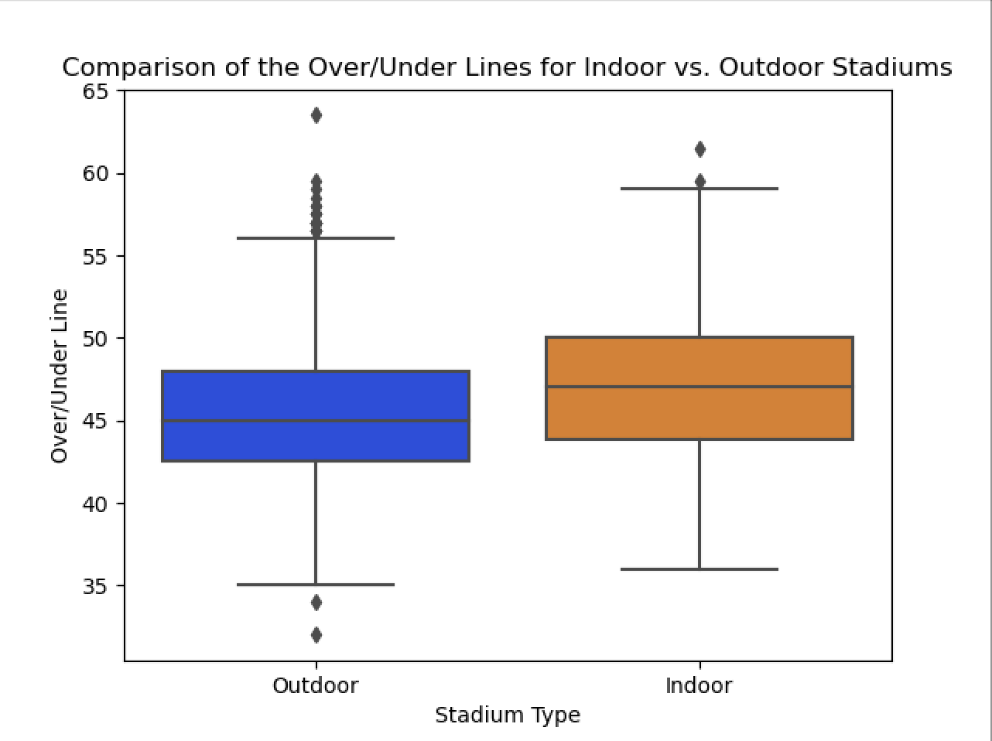
Over/Under By Stadium

Slide 11
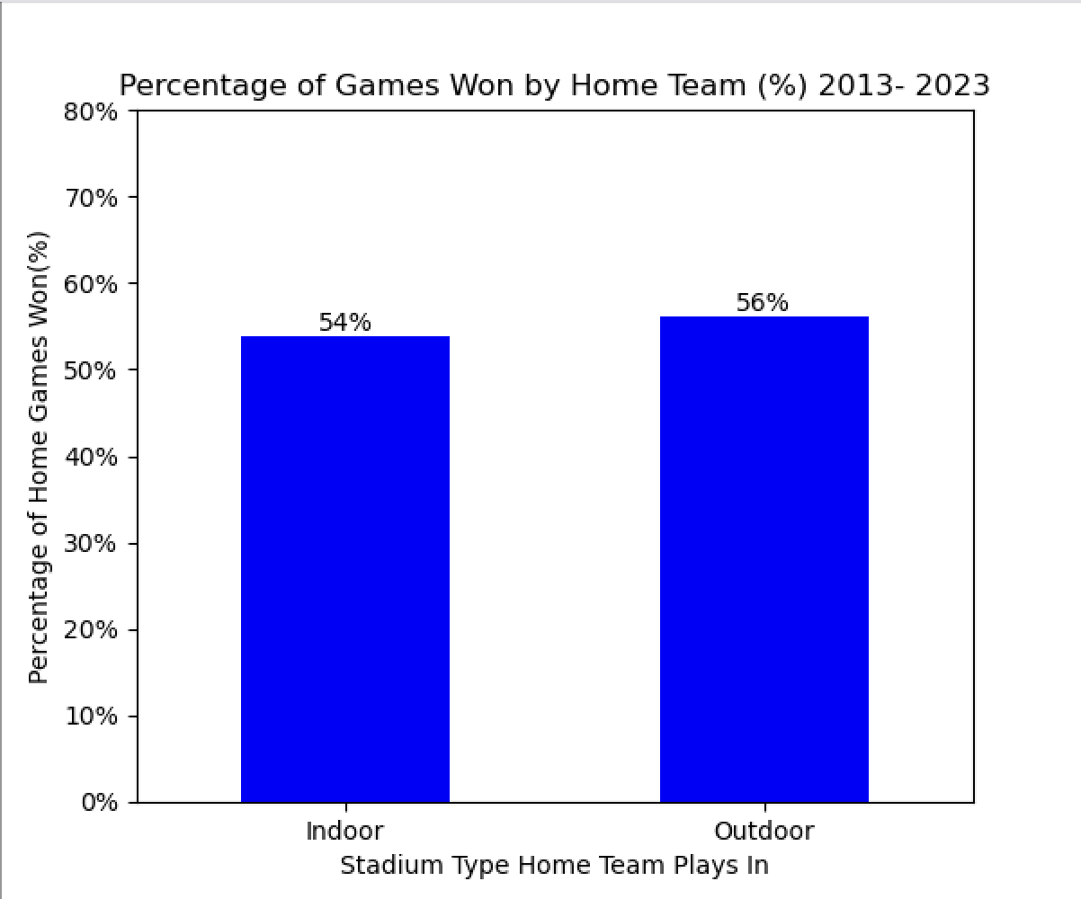
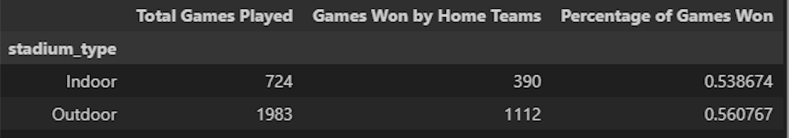
Home Field Advantage Analysis:

Slide 12
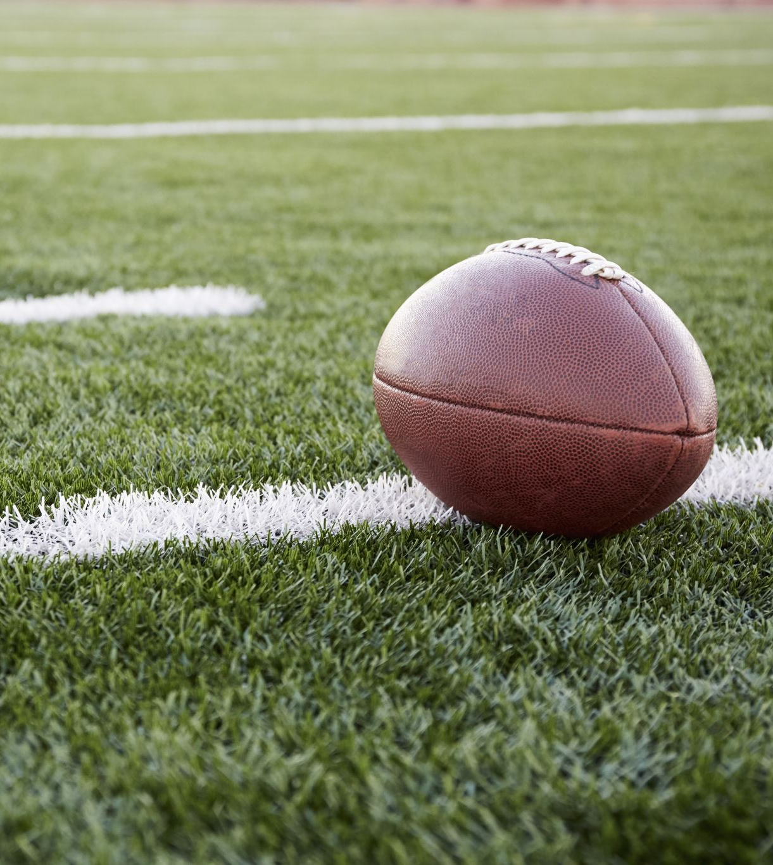
Findings:
Only 10 out of 32 NFL teams have Indoor home fields
There have been 2.73 more outdoor games than indoor since 2013
No real advantage to either home stadium type
More correlation to a slight home field advantage in general

Slide 13
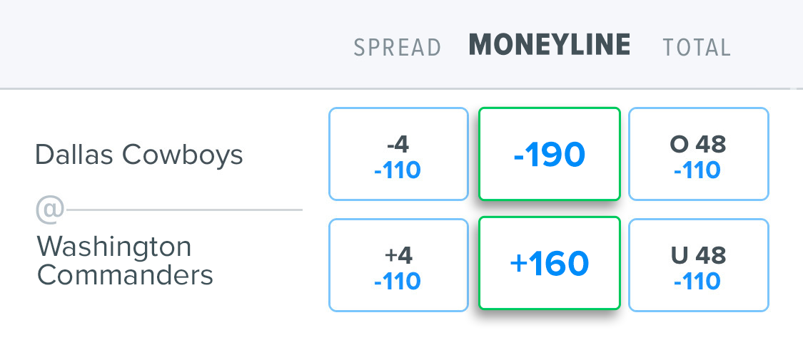
Moneyline/Favourite Team
Moneyline is a straight bet on the game picking either team to win
"-" means the team is favoured, "+" means the team is the underdog

Slide 14
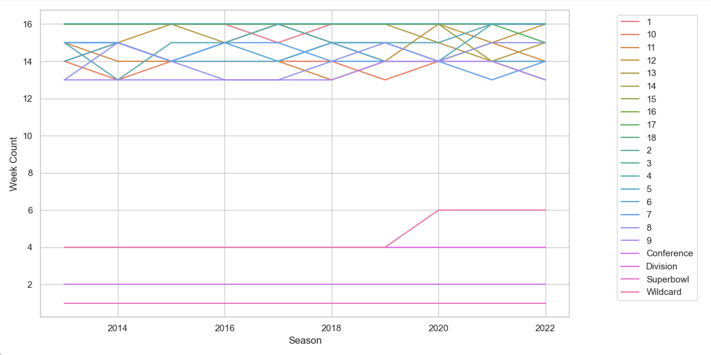
The maximum number of games a week is 16
Minimum number of games a week is 1

Slide 15
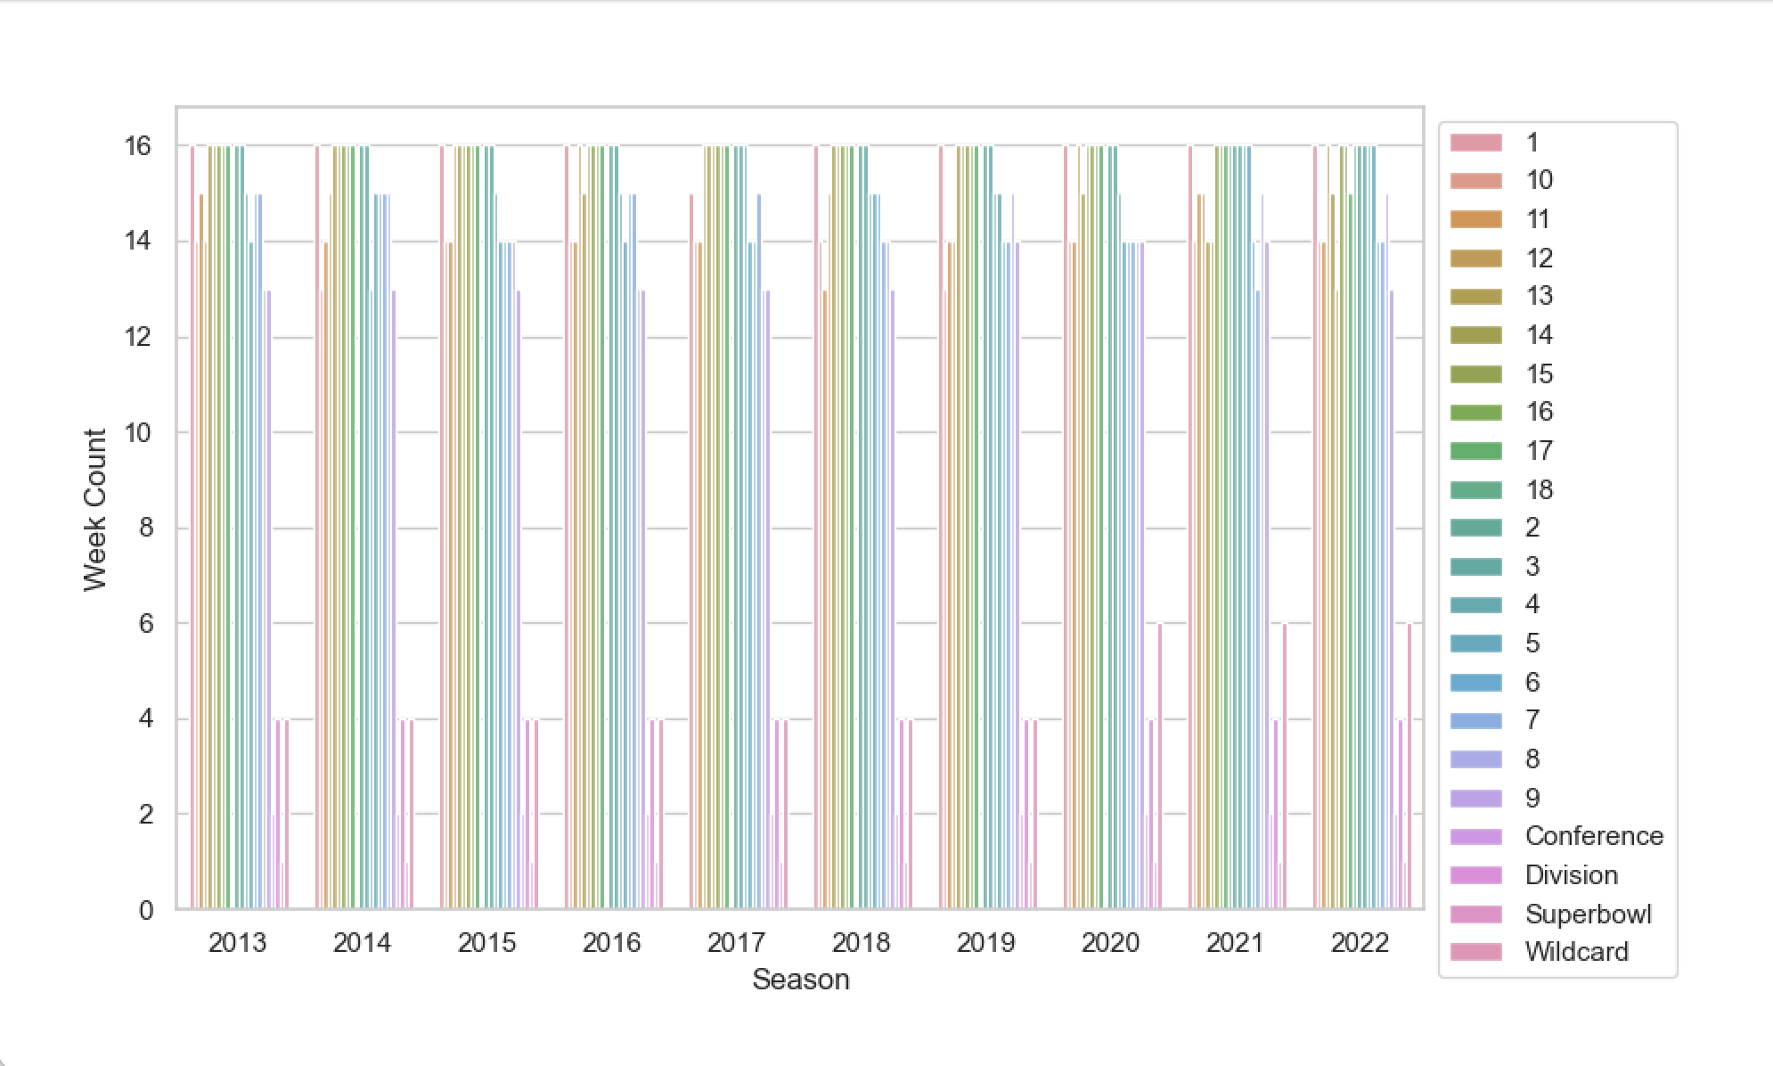
The NFL increased the number of 'Wildcard' games in 2020 to 6 games
‘Week 18' was added to the NFL schedule in 2021

Slide 16
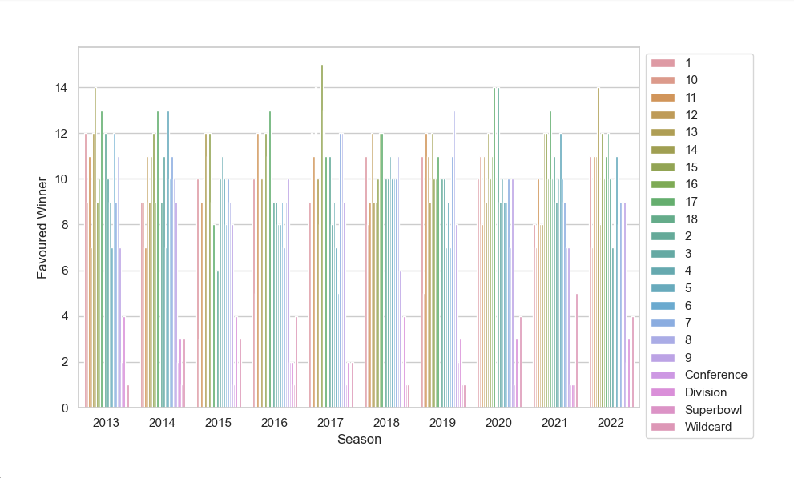
Favoured Team Winning Record per Week
Favourite team victories 1781/2707
65.79% Favourite win ratio
Underdog team victories 926/2707
34.21% Underdog win ratio

Slide 17
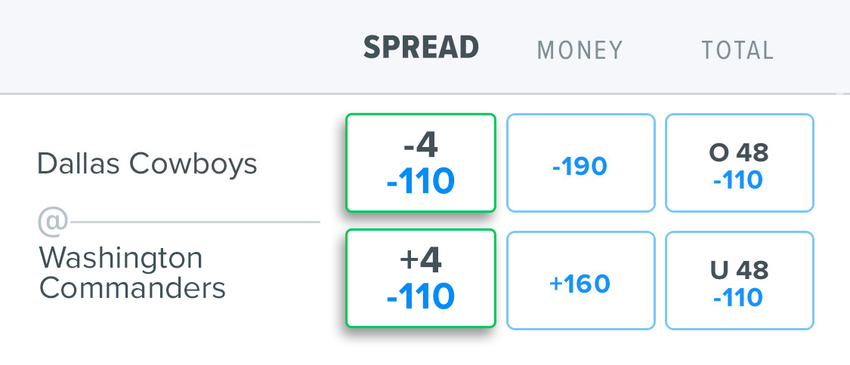
Point Spread Explained
In Point Spread, you must choose the TEAM that you think will win, but THIS IS not necessarily based on who has the winning score in the game
Instead, the winner is whoever beats or covers the Point Spread OF THE DIFFERENCE IN THE SCORE
Point Spread is expressed as a plus (+) for the underdog and a minus (-) for the favourite TEAM

Slide 18
How to Read Point Spread
Point spread helps even out the betting “playing field”
Since the favourite team is expected to win, they need to win by more than the Point Spread difference
Contrarily, since the underdog team is expected to lose, a bet on them could still win if they don’t lose over the difference set out by the Point Spread
POINT SPREAD (MATCH)
DALLAS COWBOYS -4.5 | WASHINGTON COMMANDER +4.5

Slide 19
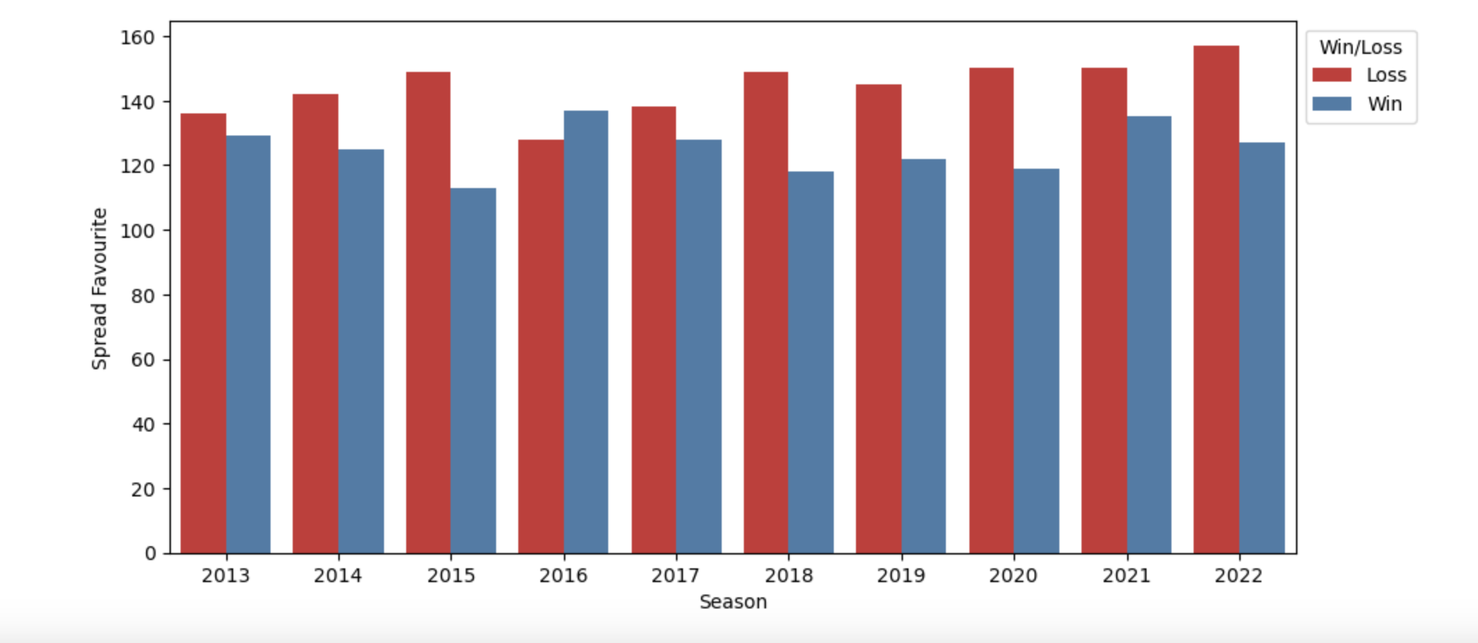
Win/Loss Results Year Over Year (2013-2022)

Slide 20
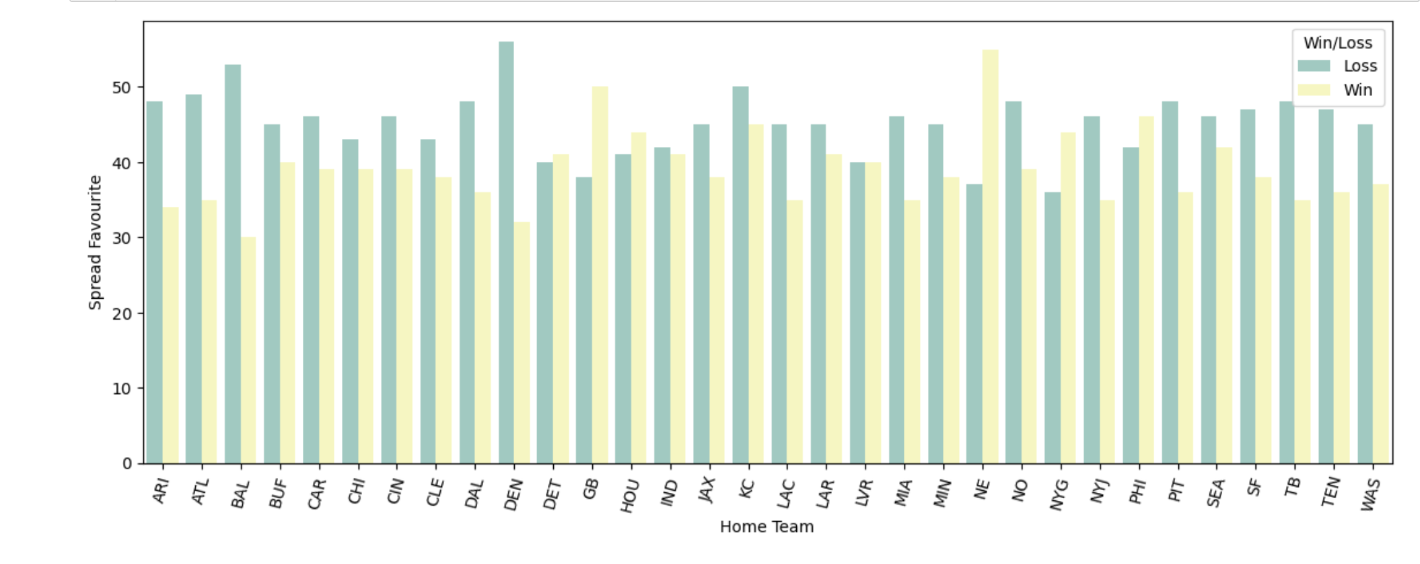
Home Team Results

Slide 21
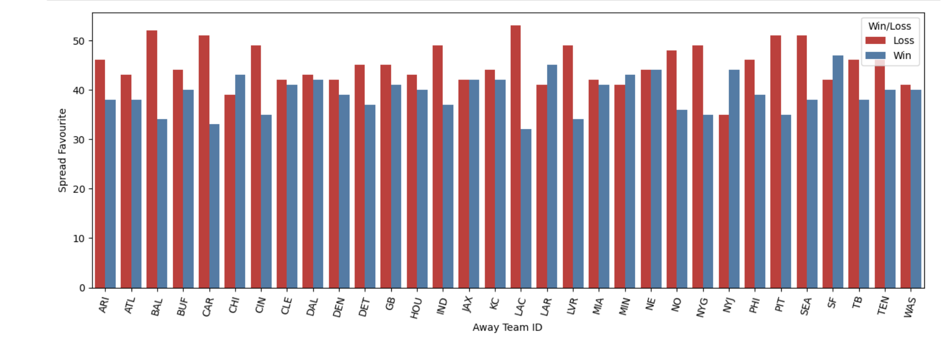
Home Away Results

Slide 22
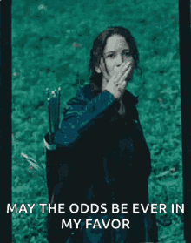
Good Luck!

Slide 23
References
https://www.kaggle.com/datasets/tobycrabtree/nfl-scores-and-betting-data
https://github.com/jp-wright/nfl_betting_market_analysis
https://sportsdata.io/developers/api-documentation/nfl#
https://github.com/jp-wright/nflgame
https://www.kaggle.com/code/twalters20/nfl-betting-model
https://www.kaggle.com/datasets/tobycrabtree/nfl-scores-and-betting-data?select=spreadspoke_scores.csv
https://www.kaggle.com/datasets/tobycrabtree/nfl-scores-and-betting-data?select=nfl_stadiums.csv
https://www.kaggle.com/datasets/tobycrabtree/nfl-scores-and-betting-data?select=nfl_teams.csv
https://www.kaggle.com/datasets?tags=16133-Gambling
https://tenor.com/search/hungergames-gifs

